Slide 1
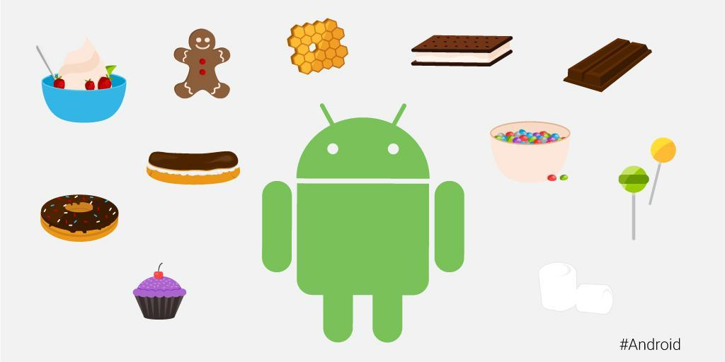

Slide 2
Android Ecosystem
Google
OEM’s
Consumers
ANDROID
Freelancers
App Dev Houses

Slide 3
Do You Know….???
What are the various Building Blocks of an Android App?
What is the Lifecycle of an Android App?
How does a Mobile App handle Hardware Events?
How does an App run Background Jobs like Network Download, Music Player etc.?
How do Multiple Apps Access Shared Resources such as Address Book, Photo Gallery etc.?

Slide 4
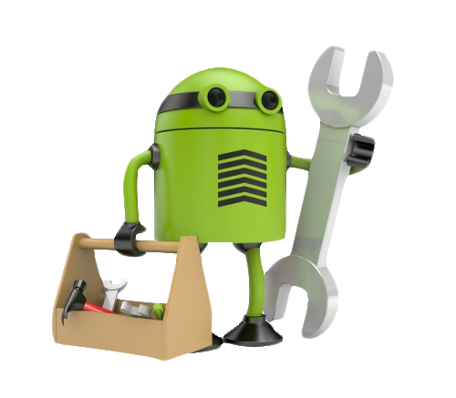
Android Overview

Slide 5
What is Android….???
Android is a open source operating system based on Linux Kernel.
It is designed primarily for touch screen mobile devices such as smart phones and tablet computers.
It was initially developed by Android Inc. and later on it was purchased by Google on 17th Aug,2005 in conjunction with the Open Handset Alliance(a group of 84 hardware, software and telecommunication companies like HTC, Intel etc.)
It was officially unveiled in 2007.
Fast application development in Java.

Slide 6
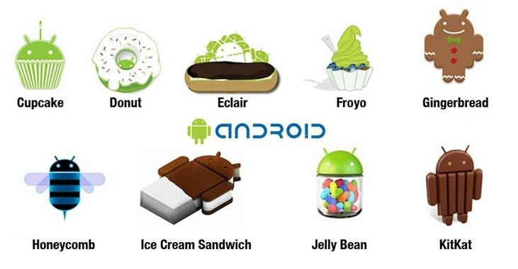
Android Evolution

Slide 7

Application Building Blocks
Intent
Activity
Service
Broadcast Reciever
Content Provider

Slide 8
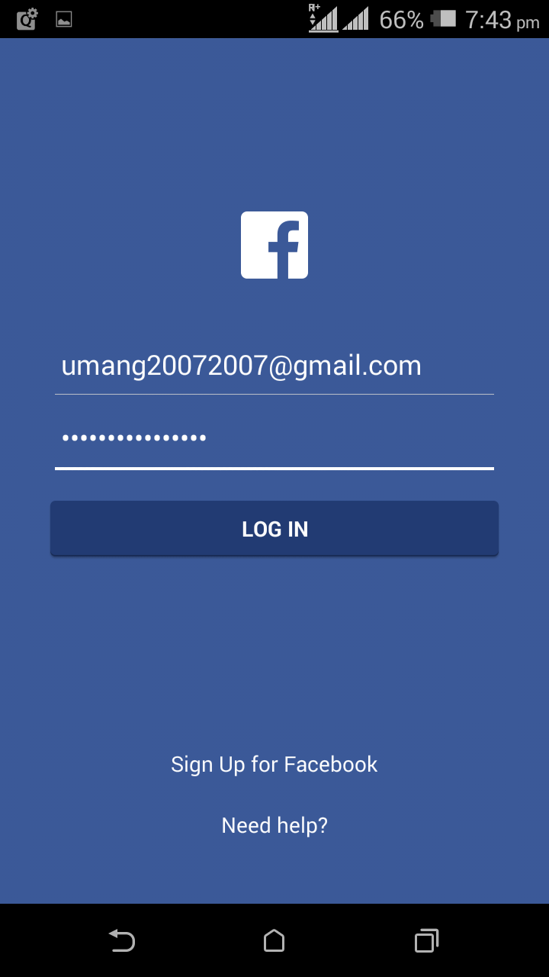
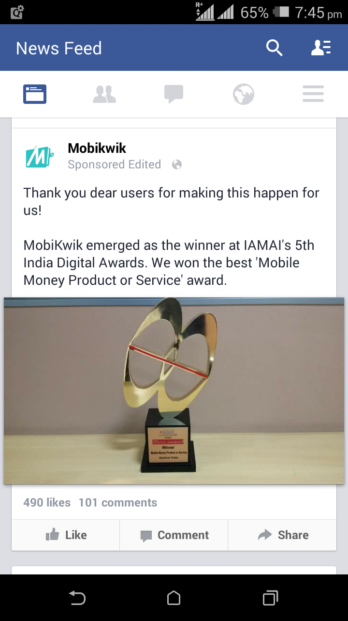
Activity-Typically a Screen
Login Activity
News Feed Activity

Slide 9
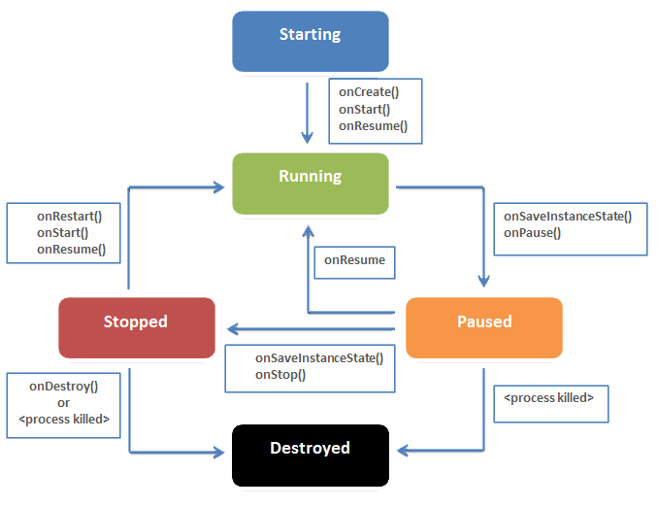
Activity Lifecycle

Slide 10
Activity Lifecycle
1) Starting State:
When an activity does not yet exist in memory, it is in the starting state.
2) Resumed/Running State:
An activity that is in the foreground is in the running state. Any activity that is currently on the screen and interacting with the user is the running activity at that particular point in time. It exists at the top of the Activity stack.
3) Paused State:
When an activity is not in focus (i.e. not interacting with the user), but is still visible on the screen, it is in the Paused state.
4) Stopped State:
An activity that is not visible on the screen, but exists in the memory is in the Stopped State.
5) Destroyed State:
A Destroyed activity results from the removal of an activity (that is no longer required) from the memory. Such removals generally occur, when the activity manager decides that there is no use for such activities anymore.

Slide 11
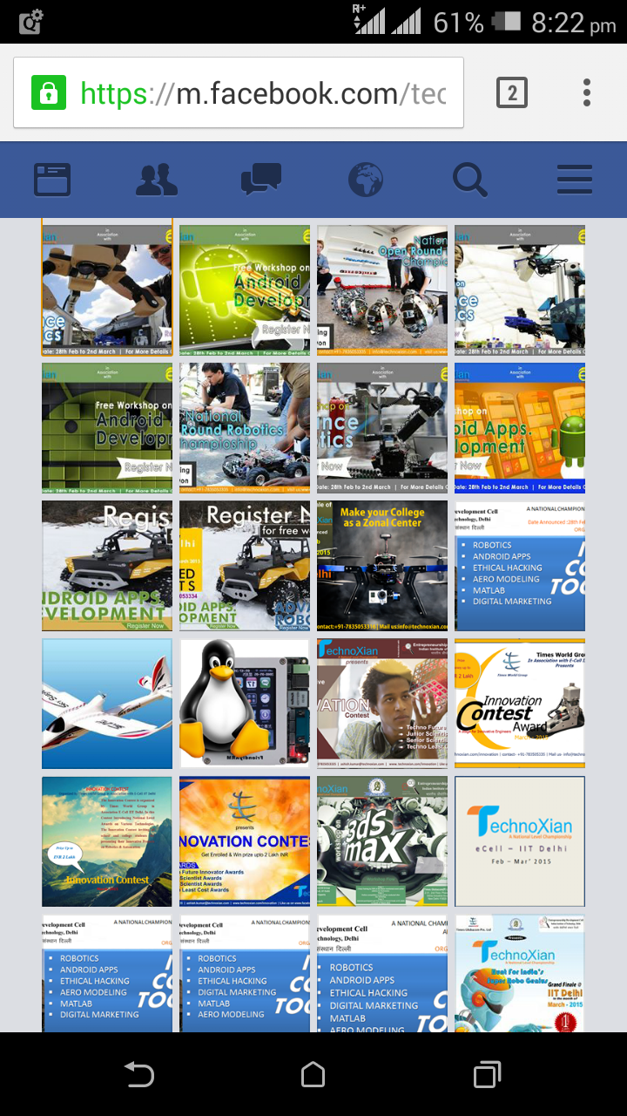
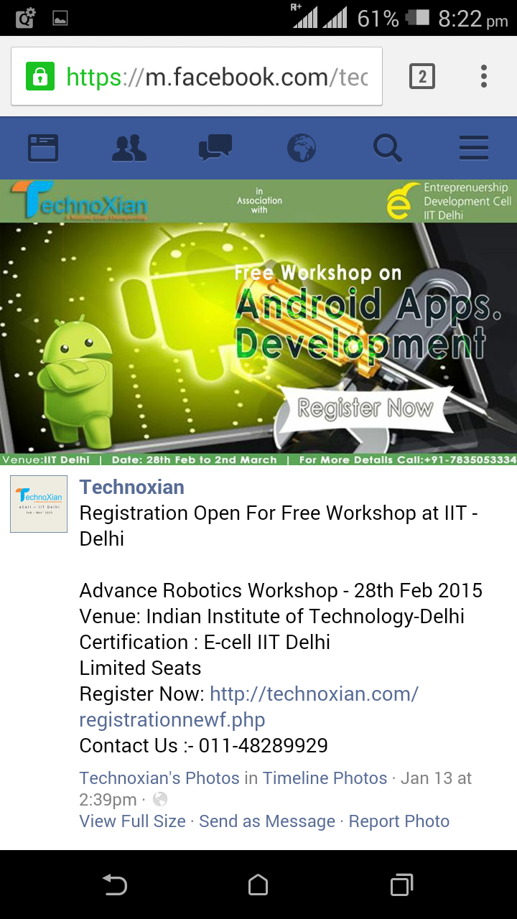
Intent-Switching Between Activities
Photo Gallery Activity
Photo View Activity

Slide 12
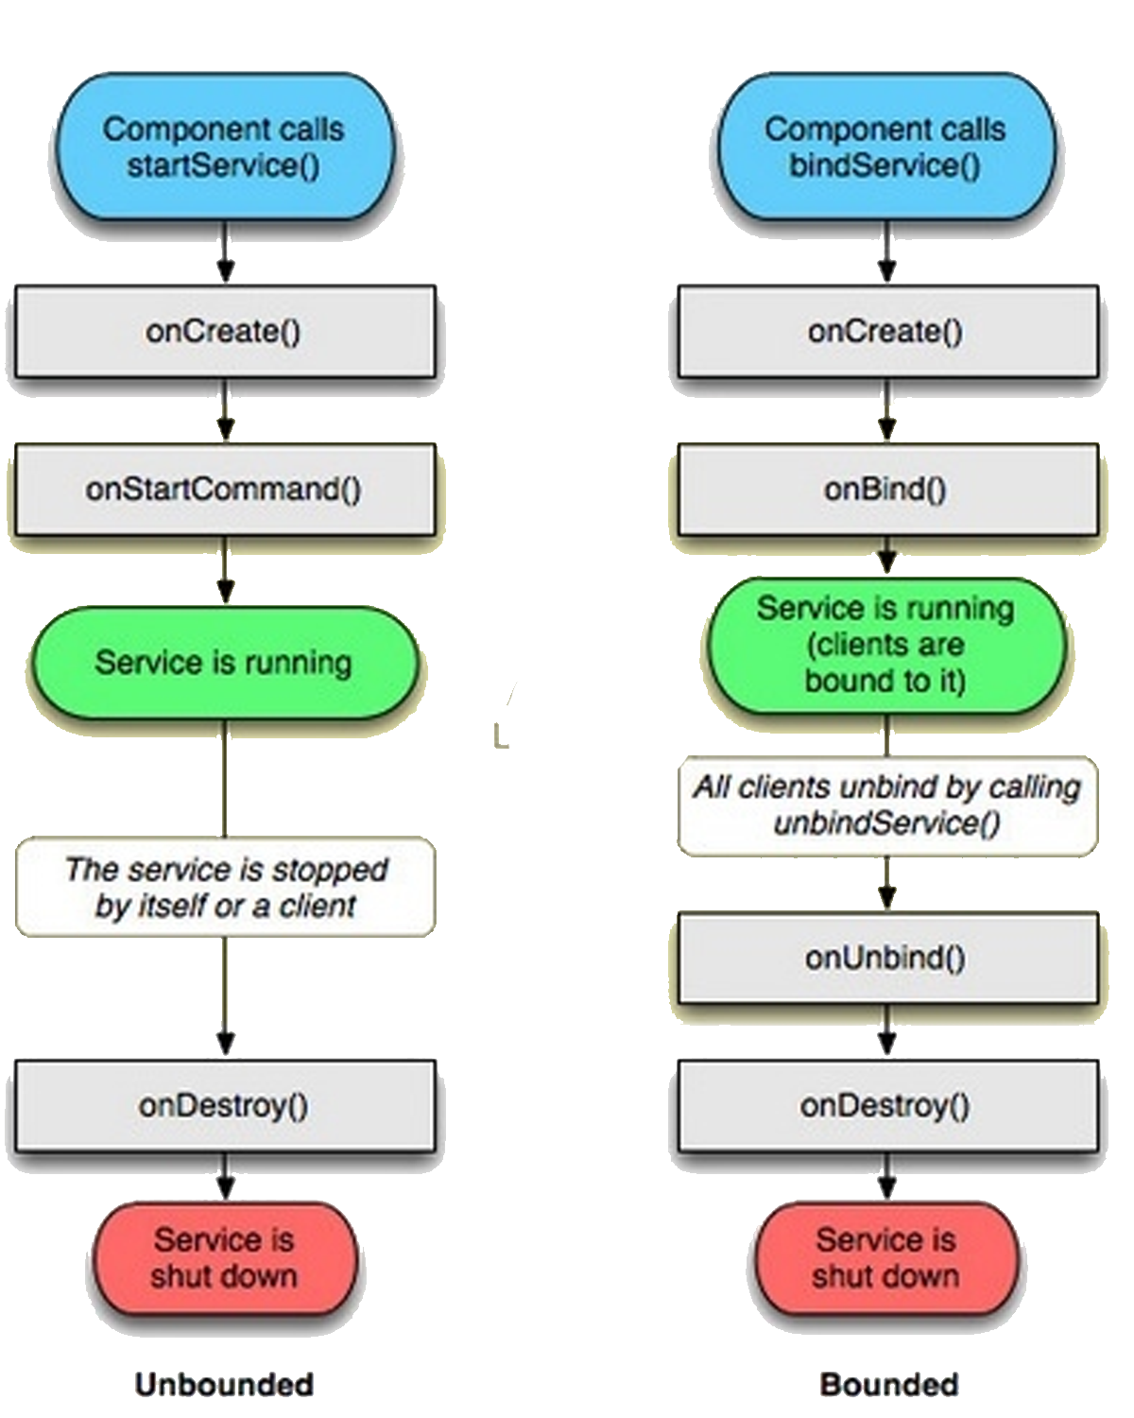
Services-Background Jobs
Faceless components running in background.
E.g.- Network Download, Notifications and friend requests in Facebook etc……
Service Lifecycle

Slide 13
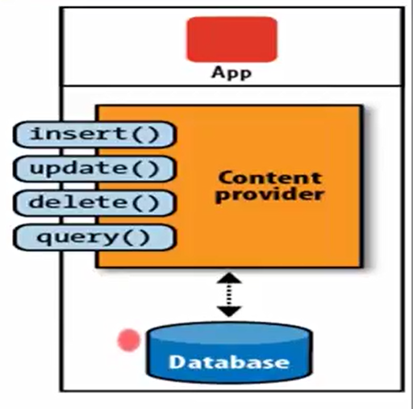
Content Providers
Enables sharing of data across applications.
E.g.- Address book, photo gallery
Provide uniform API’s for:
1)Querying
1)Delete
1)Update
1)Insert

Slide 14
Broadcast Receiver- Dormant Observer
Registers for Intent to observe
Android
System
Broadcast Receiver
Get Notification when Intent Occurs

Slide 15
Now Do You Know….???
What are the various Building Blocks of an Android App?
What is the Lifecycle of an Android App?
How does a Mobile App handle Hardware Events?
How does an App run Background Jobs like Network Download, Music Player etc.?
How do Multiple Apps Access Shared Resources such as Address Book, Photo Gallery etc.?

Slide 16
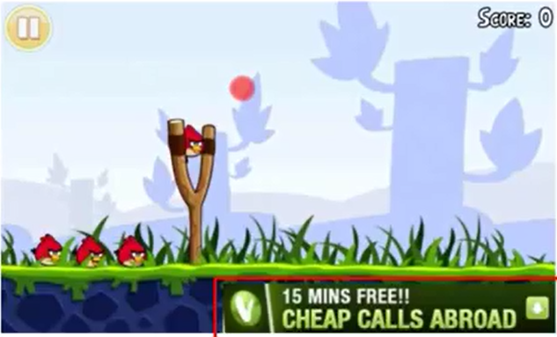
App Monetization

Slide 17
Android Market Share in 2017

Slide 18
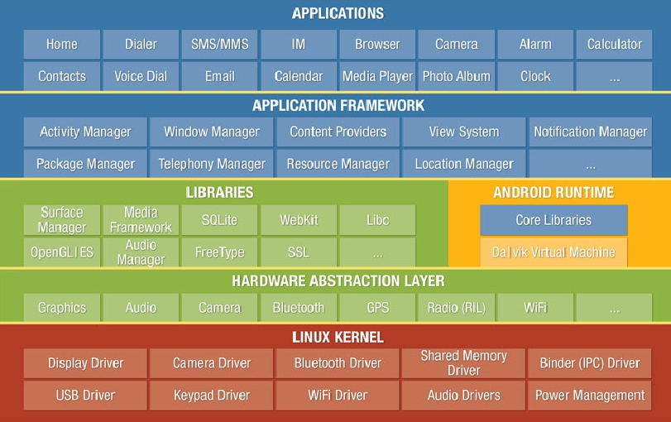
Android Architecture

Slide 19
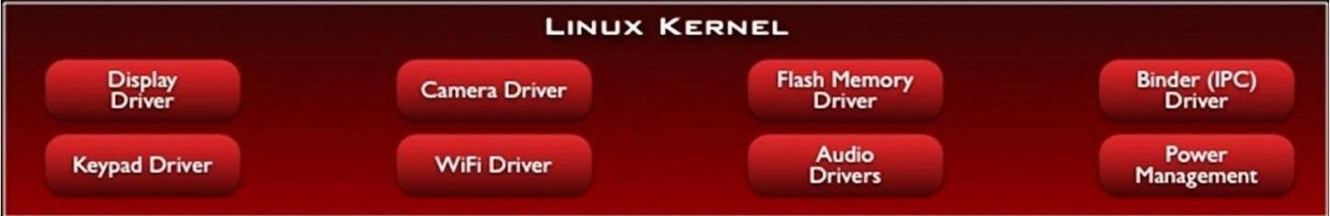
The architecture is based on the Linux2.6 kernel.
This layer is core of android architecture. It provides service like power management, memory management, security etc.
It helps in software or hardware binding for better communication.

Slide 20
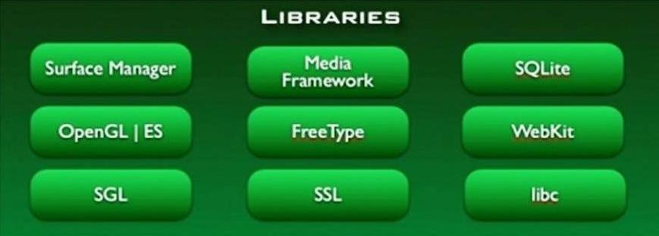
Android has its own libraries, which is written in C/C+ +. These libraries cannot be accessed directly. With the help of application framework, we can access these libraries. There are many libraries like web libraries to access web browsers, libraries for android and video formats etc.

Slide 21
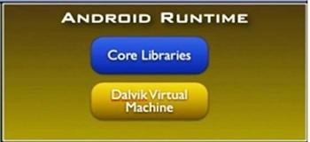
The Android Runtime was designed specifically for Android to meet the needs of running in an embedded environment where you have limited battery, limited memory, limited CPU.
Dalvik is the process virtual machine in Google's android operating system. It is the software that runs the apps on android devices. Dalvik is thus an integral part of android ,which is typically used on mobile devices such as mobile phones and tablet computers.
Programs are commonly written in java and compiled to byte code.

Slide 22
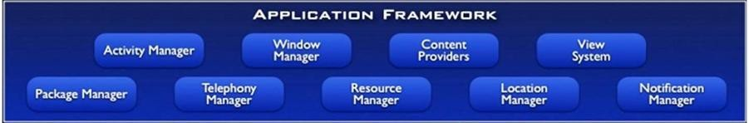
This is all written in a Java programming language and the application framework is the toolkit that all applications use.
These applications include the ones that come with a phone like the home applications, or the phone application.
It includes applications written by Google, and it includes apps that will be written by you.
So, all apps use the same framework and the same APIs.

Slide 23
These are as follows:
Activity manager:-It manages the lifecycle of applications. It enable proper management of all the activities. All the activities are controlled by activity manager.
Resource manager:-It provides access to non-code resources such as graphics etc.
Notification manager:-It enables all applications to display custom alerts in status bar.
Location manager:- It fires alerts when user enters or leaves a specified geographical location.
Package manager:-It is use to retrieve the data about installed packages on device.
Window manager:-It is use to create views and layouts.
Telephony manager:-It is use to handle settings of network connection and all information about services on device.

Slide 24
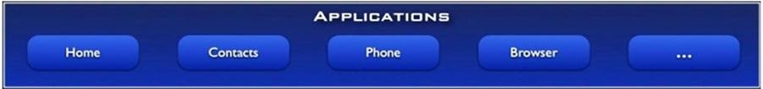
The final layer on top is Applications.
It includes the home application the contacts application , the browser, and apps.
It is the most upper layer in android architecture.
All the applications like camera, Google maps, browser, sms, calendars, contacts are native applications. These applications works with end user with the help of application framework to operate.

